Slide 1
PHASE ONE PUBLIC ENGAGEMENT WEBINAR
August 28, 2024 | 12:00 PM (EST)
SAWMPO.ORG/LONG-RANGE-PLANNING

Slide 2
Welcome to the SAWMPO LRTP Webinar
This webinar is being recorded. By staying in this session, you consent to being recorded
Use the Q&A pod to ask questions throughout the session
Select CC for closed captioning functionality
Chat SAWMPO Support if you experience technical issues during the webinar

Slide 3
2050
STAUNTON-AUGUSTA-WAYNESBORO
LONG RANGE TRANSPORTATION PLAN
Welcome & Introductions
Overview of the 2050 Long Range Transportation Plan (LRTP) update
Visioning Survey How-To
Q&A

Slide 4
Paula Melester
Brad Arrowood
Our Team
Director of Transportation
CSPDC
SAWMPO Policy Board Chair
Brad Reed
Garreth Bartholomew
District Planner Staunton District
VDOT
Transportation Planner
CSPDC

Slide 5
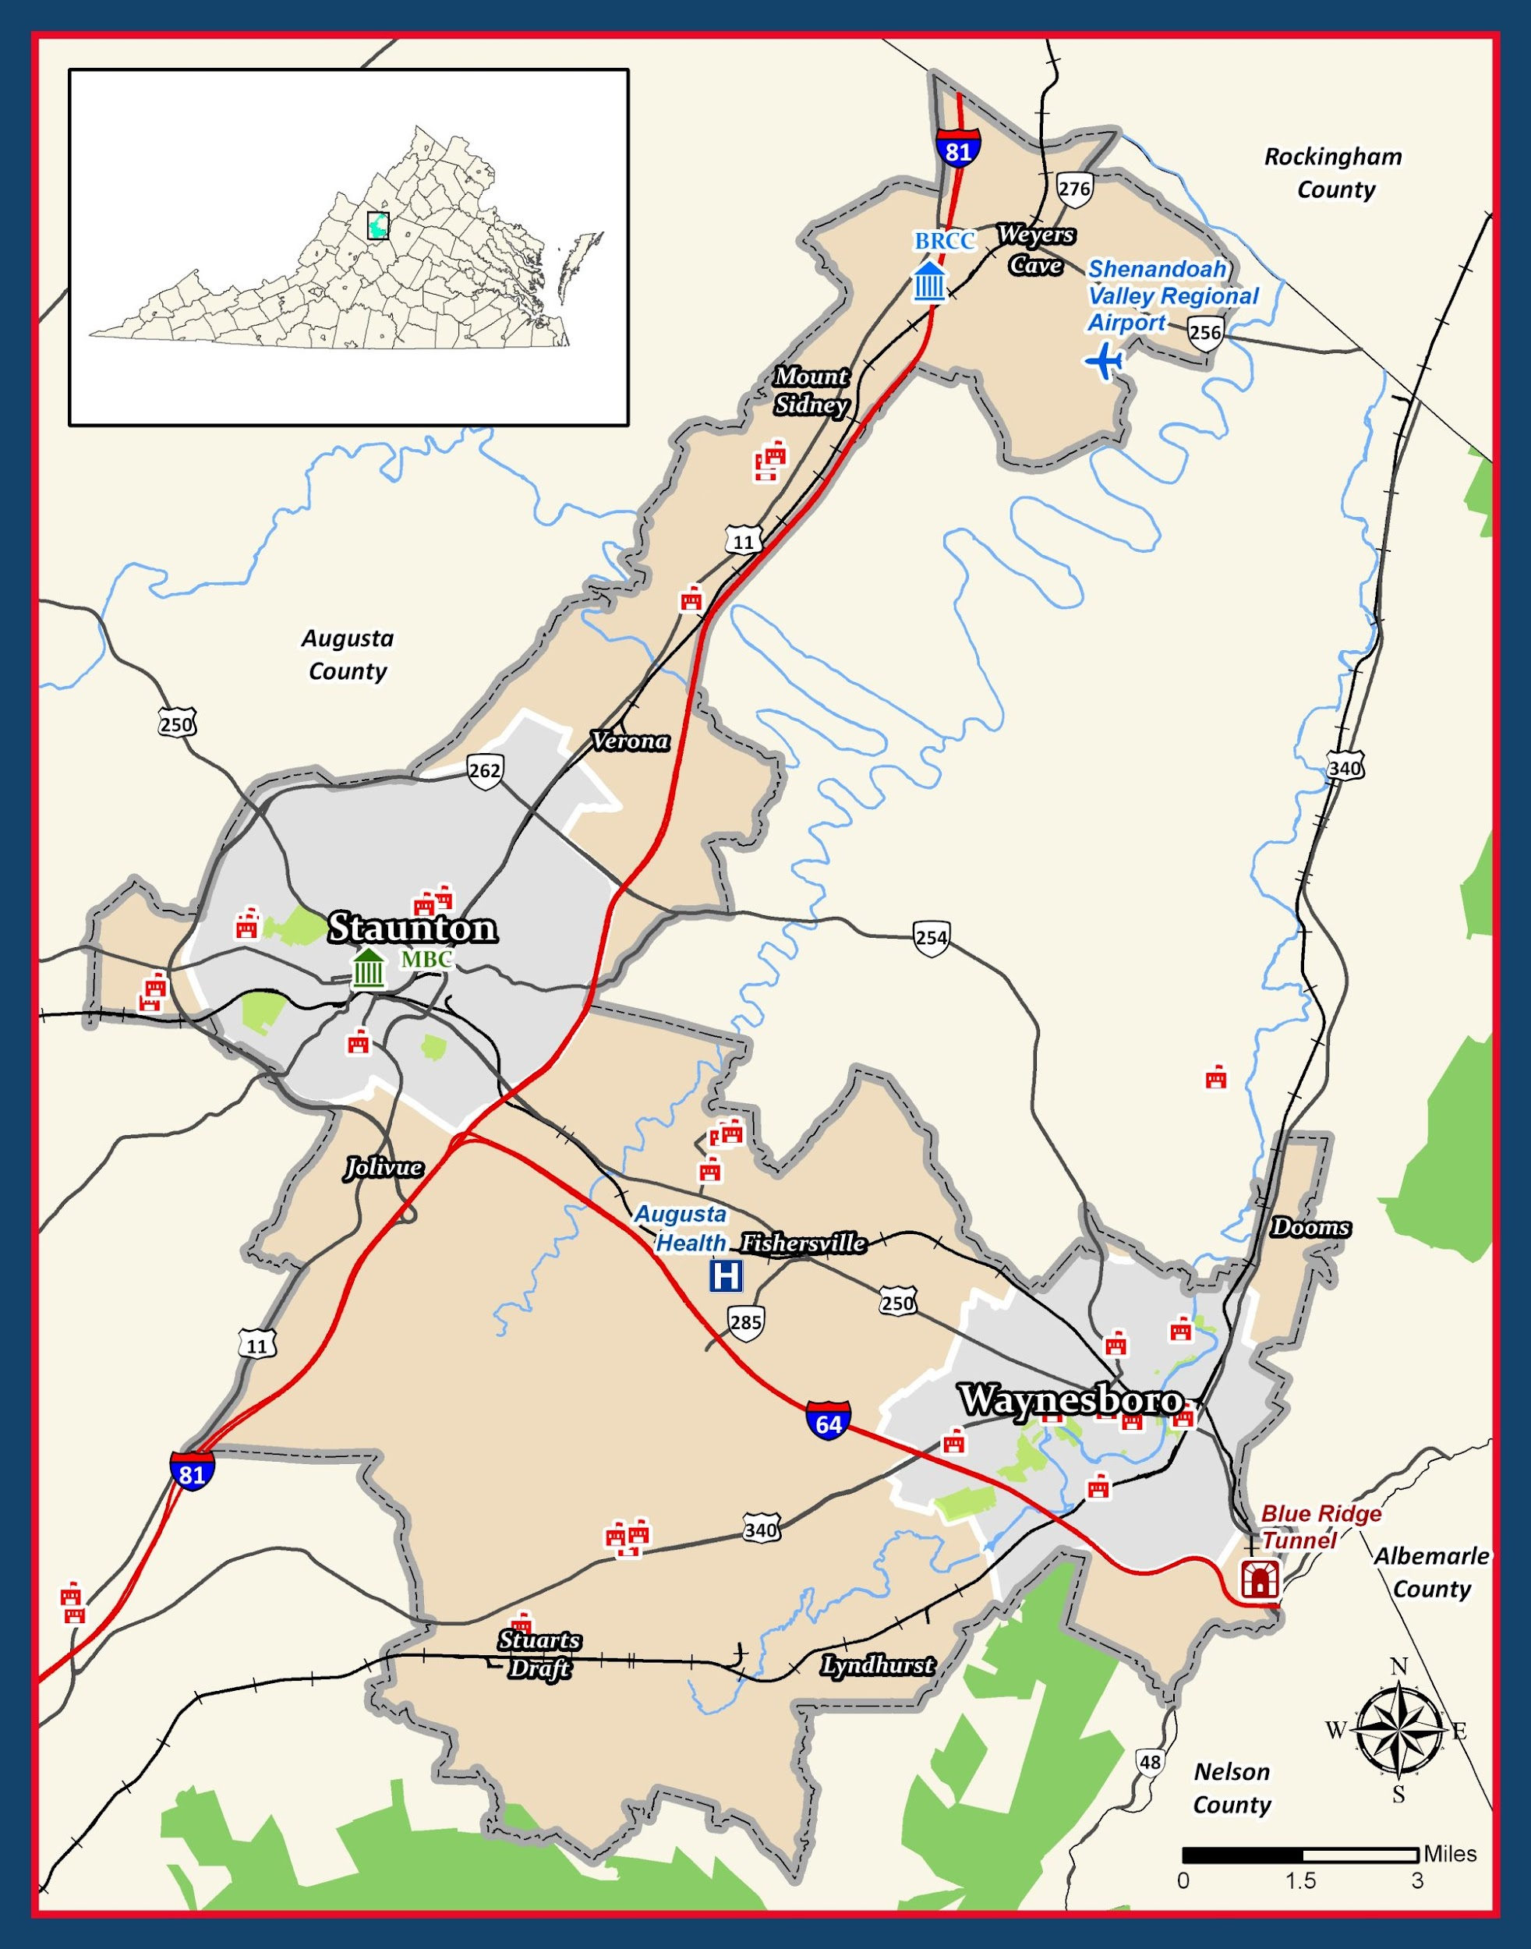
WHO WE ARE
SAWMPO is the regional transportation planning organization that provides support for multimodal transportation projects in the Staunton, Augusta, and Waynesboro region.

Slide 6
Policy
Board
Elected officials and high-level staff from our member jurisdictions, and transportation agency representatives
Technical
Advisory
Committee
Staff from our member jurisdictions with technical expertise in planning, engineering, and other related areas
The SAWMPO is staffed by the
Central Shenandoah Planning District Commission (CSPDC) and supported by our VDOT District Planners

Slide 7
WHAT WE DO
SHORT-RANGE PLANNING
Collect, analyze, and evaluate transportation data to identify needs and projects...
Unified Planning Work Program (UPWP)
Transportation Improvement Plan (TIP)
Small Area Studies (In-depth)
LONG-RANGE PLANNING
Long-Range Transportation Plan (25-Year Plan)

Slide 8
2050 LRTP Update Process
Identifies transportation needs over a 25-year period
Matches transportation projects to the region’s needs
Creates a road-map for investments in transportation

Slide 9
SAWMPO 2050
Public Input Timeline
Phase One
Phase Two
Phase Three
Publish LRTP!
Visioning
Universe of Projects
Draft Plan Review

Slide 10
How can I get involved?
Phase One Engagement Activities
Take the survey between August 12 and September 30
Come talk to us in person at one of the pop-up events in your community
Visit our website and sign up to receive email updates throughout the process
Tell your neighbors, friends, and family about the LRTP!

Slide 11
2050 LONG RANGE TRANSPORTATION
PLAN VISIONING SURVEY
Take it on a computer, tablet, or smartphone
Intuitive ‘drag-and-drop’ mapping tool
Available in English and Spanish
*Paper copies available by request

Slide 13
In-Person Community Pop-Ups
Contact:
Paula Melester
Director of Transportation
(540) 885-5174 ext. 107 / paula@cspdc.org
Newtown Neighborhood Block Party
September 2nd – 5:00 PM – 7:00 PM
Lewis Street Transit Hub
September 10th – 12:00 – 2:30 PM
Waynesboro Farmer’s Market
September 14th – 9:00 AM – 1:00 PM
Staunton’s African-American Heritage & Multicultural Festival
September 21st – 10:00 AM – 2:00 PM
Verona Farmer’s Market
September 26th - 10:00 AM - 1:00 PM

